Slide 1

Churn Prediction Project
Leveraging Machine Learning to Preserve Current Customers
By: Seif Mohamed Hatem Hegazy
ID: 833744 (AI Department)

Slide 2
Table of Contents
01
02
03
04
05
06
Introduction
Research Papers
Dataset
EDA
Modeling
Conclusion

Slide 3

Introduction
What is Customer Churn?
Customer churn refers to clients leaving a service provider over time, posing a significant threat to business stability.
Importance in Banking Sector:
Revenue Impact
Preserving Customers vs. Attracting new ones
Customer Lifetime Value
Business Problem:
Identifying customers that are inclined to leave early on, to help banks take proactive measures.
In-Scope Products:
Credit Cards
Notes:
Importance in Banking Sector:
Revenue Impact: Retaining customers is crucial for maintaining revenue and profitability.
Cost Efficiency: It is far more cost-effective to retain existing customers than to acquire new ones.
Customer Lifetime Value: Loyal customers tend to use more services, maintain higher balances, and refer others, all of which contribute to the bank's bottom line.
Business Problem:
Identifying at-risk customers early can help banks take proactive measures (Ex:) to prevent churn.
Addressing churn is essential for sustaining growth and competitive advantage in the market.

Slide 4
Summary of The Research Papers
Paper 1: Churn Prediction Using Machine Learning Techniques:
Authors: Dana AL-Najjar, Nadia Al-Rousan and Hazem AL-Najjar (2022)
Objective: Predict customer churn using various methods.
Key Contributions:
Used preprocessing to improve data quality.
Tested different types of tree based models.
Achieved high accuracy.
Significance:
Highlighted the importance of data preparation.
Paper 2: Advanced Models and Techniques for Customer Churn Prediction:
Authors: Srinivasan Rajendran and Rajeswari Devarajan (2023)
Objective: Explore advanced methods and combinations.
Key Contributions:
Used a mix of simple and advanced models.
Created new combined models.
Applied innovative methods for better predictions.
Significance:
Showed the power of combining different techniques.

Slide 5
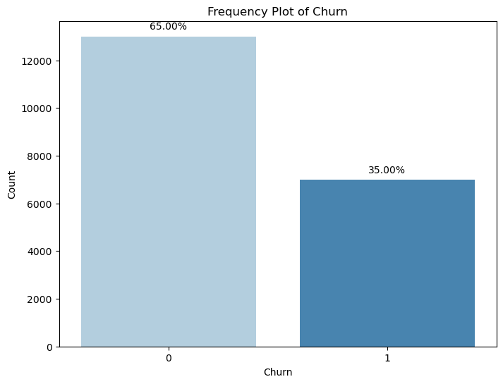
Dataset
Distribution of Churn vs Non-Churn Customers
General Overview:
One Month Snapshot of data:
Dataset Size: 20,000 accounts with 56 features.
Feature Types: Customer demographics, Spending patterns, Account information.
Objective: Predicting Churn/ Non-Churners

Slide 6
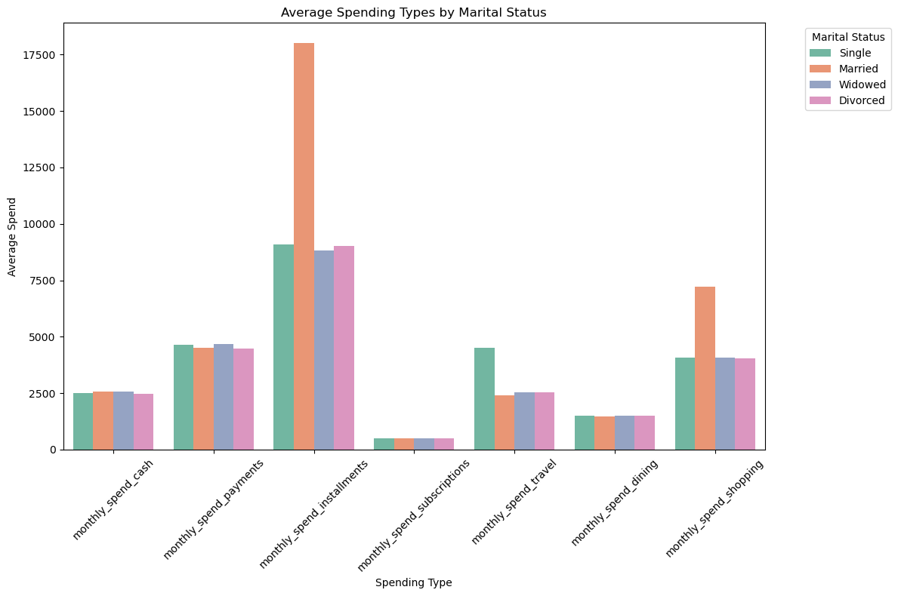
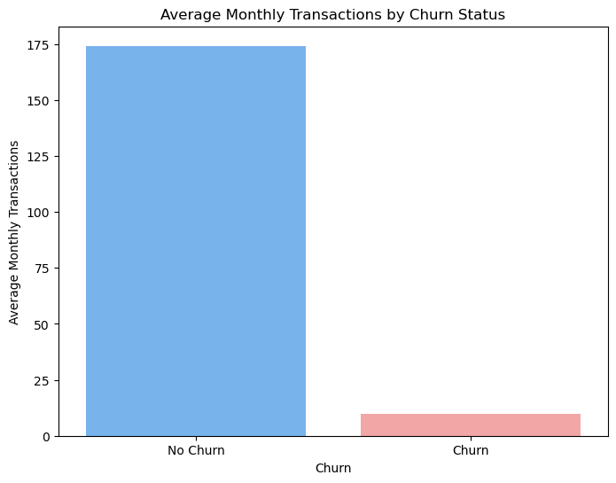
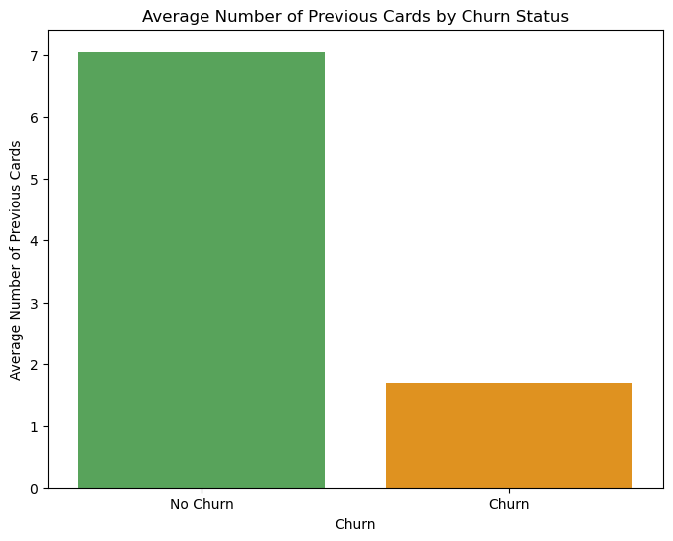
EDA
Martial status vs monthly spend types
⁠Average monthly transactions vs churn
⁠Number of ⁠previous cards vs churn

Slide 7
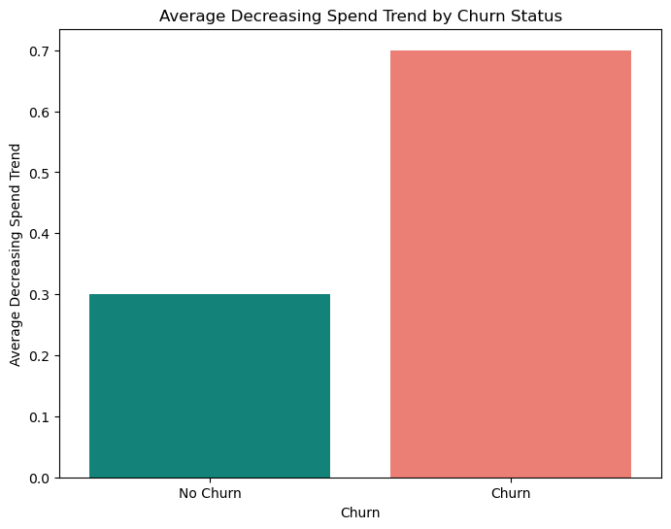
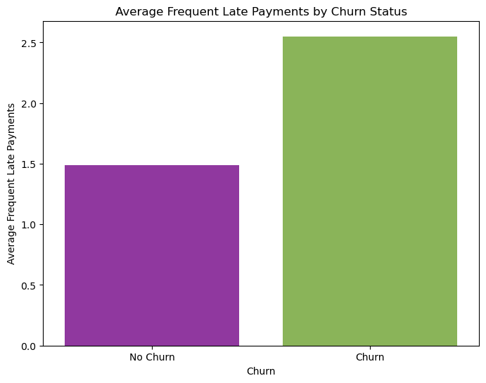
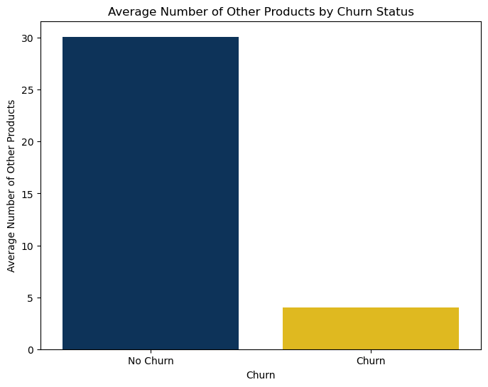
EDA
Decreasing spend trend vs churn
⁠Frequent late payments vs churn
⁠Number of ⁠other products vs churn

Slide 8
Modeling
Logistic Regression
Phase-1: Default Weights
Phase-2: Custom Weights
Train Data:
Precision 64%
Recall: 25%
Model score: 36%
Test Data:
Precision: 61%
Recall: 24%
Model score: 35%
Train Data:
Precision 49%
Recall: 60%
Model score: 54%
Test Data:
Precision: 48%
Recall: 59%
Model score: 53%

Slide 9
Conclusion
Successfully identified key indicators of customer churn, aiding in early detection of customers inclined to leave.
Machine learning models, especially with class balancing, improved performance in predicting churn.
Highlighting the importance of proactive preservation measures, boosting revenue and cost efficiency.

Slide 10
Thank You

